Slide 1
Recursive and Iterative
By Benny Guan

Slide 2
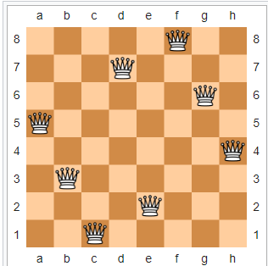
Pre-Class: 8 Queens Puzzle
The eight queens puzzle is the problem of placing eight chess queens on an 8×8 chessboard so that no two queens threaten each other; thus, a solution requires that no two queens share the same row, column, or diagonal.
Try to design one……….
How many possible solutions

Slide 3
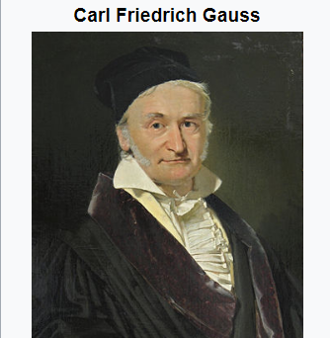
8 Queens Problem
German mathematician Carl Friedrich Gauss able to find 76 solutions during his lifetime
Total distinct solutions is 92

Slide 4
Human’s mind: iterative
From easy to hard
1,2,3,4,5……100……1000
Abc, words, grammar, essay
5!= 1*2*3*4*5

Slide 5
Computer’s mind: recursive
5! = 5*4! = 5*4*3! = 5*4*3*2! = 5*4*3*2*1! = 120
From top to down
Can repeat itself

Slide 6
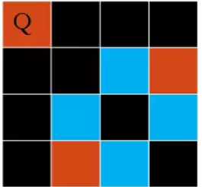
4 Queens problem

Slide 7
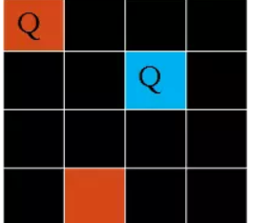
4 Queens problem

Slide 8
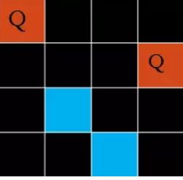
4 Queens problem

Slide 9
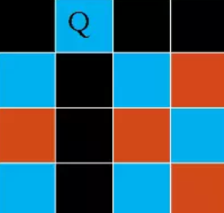
4 Queens problem

